Slide 1

How will the credit union industry evolve to manage digital assets?

Slide 2

The focus group
Today, there is no platform that warrants authenticity, originality, marketability and transferability
for electronic contracts, i.e., loans, insurance, securities, etc. This focus group will determine:
The level of awareness in the CU industry
The level of support in the CU industry
The perceived value of such a platform specifically for the CU industry
The business requirements needed to make this a reality

Slide 3
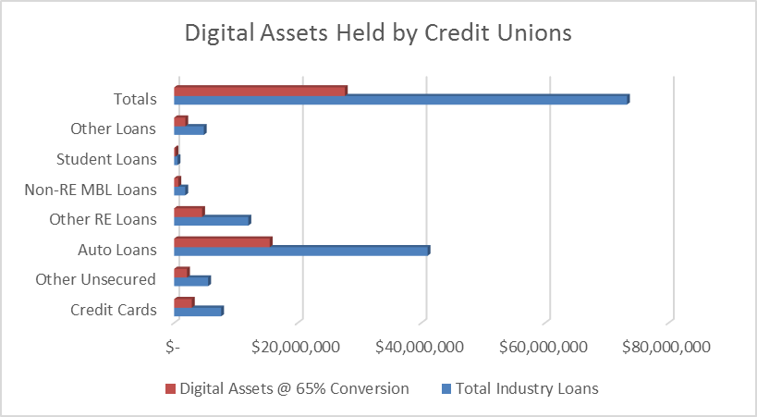
A quick fact:
It is estimated that $27B (65%) of credit union loan portfolios are in the form of digital assets.

Slide 4
Case Study – 265 Credit Unions
Research was performed on a cohort of 265 eDOC Innovations credit union clients for the purpose of addressing the following three questions:
How many credit unions use DTM in-branch solutions today?
How many credit unions have adopted mDTM for mobile signing?
How much of the credit union’s loan portfolio is digital today through the use of DTM or mDTM?

Slide 5
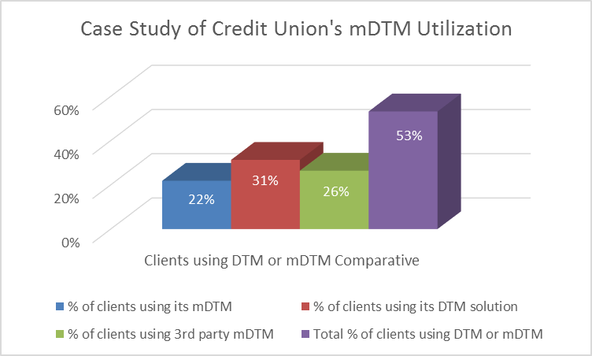
Here is what we learned.
Internal research revealed that 23% of our client base have license for a represented mobile enterprise digital transaction management (mDTM) solution for remote environments; 62% of which are actively utilizing remote signing, and 32% have a DTM solution.
eDOC’s surveys suggest an additional 26% of eDOC’s client base have an DTM/mDTM solution from a 3rd party.

Slide 6
Case Study Feedback
One credit union reported, “[We] are digitally signing nearly 100% of all consumer loans, with very few exceptions. We see monthly averages of 30-40% remote closings, the rest digitally - in branch. Home Equity loans are still printed and signed today, but we will be looking to digitalize what we are able to later this year.”
Another credit union reported, “I [estimate] well over 50%, [as high as] 75% now [digital], as we have been using the sig pads in-house for years now.”
The research data suggests that credit unions utilizing DTM and/or mDTM solutions from eDOC have nearly 70% of their consumer loan portfolios as digital assets, and that percentage is growing.

Slide 7
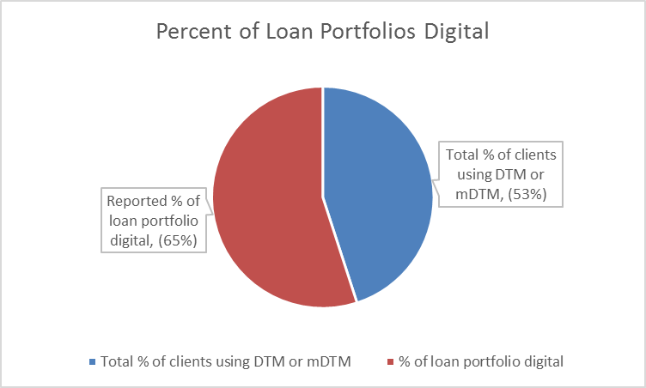
There is a growing pool of digital assets in credit union’s loan portfolios.

Slide 8
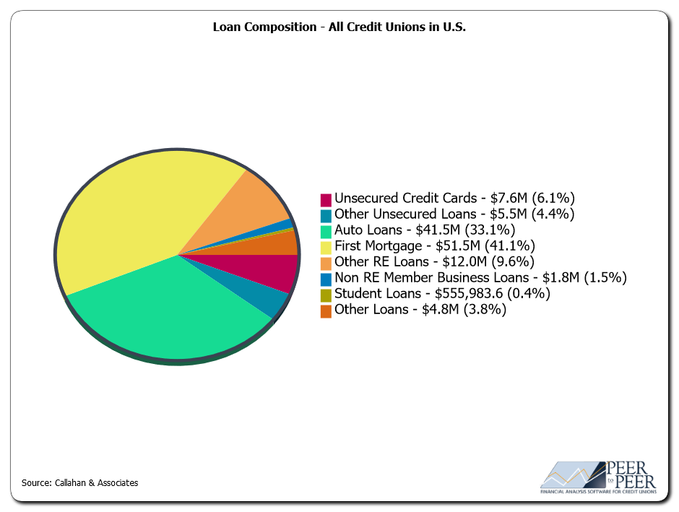
Industry Comparative
Callahan & Associates report indicates the industry is servicing approximately $125B in loans today.
Is it reasonable to assume that the case study findings are fundamentally representative of the general industry demographic?

Slide 9
  Applying the case study findings to the general credit union industry, here is what we see.

Slide 10
Digital Asset Value
Breaking down the different digital asset classifications, here is what we see for digital asset value in the industry today.
Callahan & Associates, 2016

Slide 11
Business implications
The accelerating pace of digital asset conversion poses at least two material points for consideration and evaluation:
Digital asset identification and authentication
Digital asset collateralization

Slide 12
Authentication & Collateralization
Digital asset authentication is the ability to warrant that a digital asset is:
“Authentic”, executed with all due formalities; and,
“The Original”, the authoritative copy of the digital asset that is unique, identifiable, and unalterable.

Slide 13
Effective authentication of digital assets address these consequences, which exist when a credit union fails to effectively authenticate its digital assets:
Risk of regulatory reprisal in audit
Risk of insurance or bond coverage cancellation
Risk of liquidity cancellation or reduction
Exposure to UETA and ESIGN regulatory penalties
Failure to uphold litigious dispute of transaction, including: intent, fees, disclosure, etc.
Failure to substantiate repossession of asset
Inability to market or transfer the asset

Slide 14
Requirements for a digital asset to be secured, pledged, as collateral requires the pledger to warrant that a digital asset is:
Compliant: evidence that the borrower has “affirmatively consented to use electronic records for the transaction (UETA); and,
UCC Controlled: verifiable, secured for lender control.
Insured: insurance protection for violations in privacy or unauthorized access; and,
Transferrable: transfer ownership with certainty.

Slide 15
In April of 2014, a credit union’s credit line with FHLB, secured for liquidity purposes, was reduced due to the credit union’s inability to provide adequate assurances for securitization, and collateralization, for its then digital loan portfolio of $15M.
Here’s what the FHLB said:
“In order for the FHLB to continue to accept e-notes as eligible collateral for borrowings [we must have] assurance of their marketability [and accessibility] should we have to take possession of the notes and sell them to satisfy outstanding advances.”

Slide 16
Traditional outlooks on digital transaction processing are evolving with state and federal agencies, who openly acknowledge the value and business requirement for credit unions to engage in digital transaction management in order to remain relevant.
Here’s an example of this evolution:

Slide 17
In April of 2014 Nicholas Ballasy reported: WASHINGTON – The CFPB is launching a pilot program to evaluate “eClosing” solutions and how they can improve the mortgage loan closing process.
“Our goal will be to determine how the eClosing process can be made to reflect the spirit of our Know Before You Owe rule by generating increased consumer understanding, fewer surprises at the closing table, and a more empowered consumer,” said CFPB Director Cordray on Wednesday during a forum held at the CFPB headquarters in Washington.
“This is not a rulemaking process. Instead it is a potential ‘win-win’ effort to work with all stakeholders to ensure that consumers understand the commitment they are making and experience a more transparent, efficient, and effective process,” he added. “The bureau hypothesizes that technology-enabled electronic closing (eClosing) solutions may have the potential to improve consumer understanding and empowerment and efficiency for all involved,” said the CFPB’s eClosing pilot guidelines.

Slide 18
In his remarks, Cordray also addressed the risks associated with electronic signatures.
“We have heard some concerns about data security and the risk of fraud with people using eSignatures that are not their own. Nevertheless, the federal government and every state have weighed the same concerns and adopted laws that approve the use of eSignatures,” said Cordray.
“We would also be concerned if eClosings meant that consumers could not freely and easily access a full record of the documents they signed. But there is no obvious reason why this should be a problem and lenders can easily establish a repository of electronic documents for each closing,” he also said.
CU Times, April 24, 2014

Slide 19
Business Requirements
Identify the business requirements to ensure credit unions are able to authenticate and collateralize their digital assets. Here is what we believe a solution must provide:
  Warrant the creation process (authentic)
  Consumer digital signing (due process & compliance)
  Vaulting services (custodian, lifecycle management)
  Transaction services (eNotary & UCC Conformity)
  Transferable records services (ownership tracking & transfer)

